Slide 1
Custom-Object Character Recognition(OCR) on AWS (Google Drive/ Cloud Storage)
Submitted By:-
Himanshu Sharma

Slide 2
Project Title
. Custom-objective Character Recognition (OCR) using YOLOv3 and Tesseract.
. Platforms : AWS/Google Colab/Google Drive

Slide 3
Objective
:- Build a Custom OCR to read specific contents from lab reports YOLOv3 and tesseract.
:- Output is an editable file(csv).

Slide 4
Workflow Overview
Object detection using YOLOv3
Image preprocessing (resize, grayscale,blur,threshold)
OCR using Tesseract
Export results to CSV

Slide 5
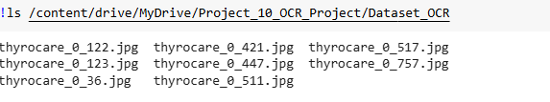
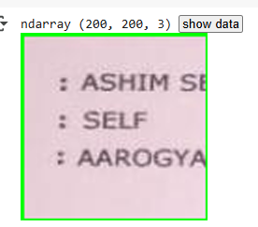
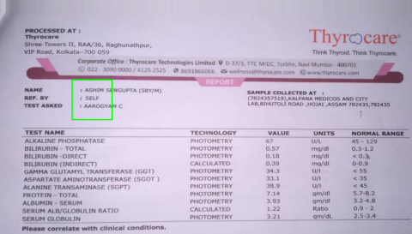

Slide 6
Envirnomental Setup
-> Google Colab:
- mount google drive
create folder structure (datasets/, models/,results/)
-> AWS SageMaker:
Launch notebook instance
Install dependencies
Ensure access to S3

Slide 7
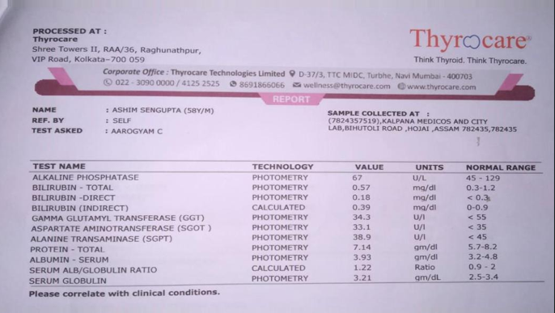

Slide 8
Data preparation
Upload dataset to google drive
Resize images
Create YOLO annotations
Store preprocessed data in drive
Train YOLOv3 model on colab
Save weights to models folder
Validate using test data
Upload results to drive

Slide 9
Inference and post-processing
Run inference on test images
Crop detected objects
Preprocess for ocr
Use tesseract to extract text
Save results as csv

Slide 10
Evaluation and Optimization
Compare ocr output with ground truth
Optimize preprocessing steps
Fine-tune YOLO/tesseract pipeline
Automate the full pipeline using cloud services
Deploy inference model vie Sagemaker or custom app

Slide 11
Conclusion
In this project, we successfully built a Custom OCR system by integrating YOLOv3 for object detection and Tesseract for text recognition. The model was trained to detect and extract specific text regions from lab report images using a custom dataset. Key achievements include:
:-Custom YOLOv3 model trained on specific lab report images.
:- Bounding box detection used to isolate relevant text areas.
:- Preprocessing techniques (resize, grayscale, blur, threshold) enhanced OCR accuracy.
:-Tesseract OCR converted cropped regions into editable text format.
:-Final results saved as structured CSV files for further analysis or use.
This approach enables automatic, accurate, and editable text extraction from lab reports, reducing manual effort and improving data processing efficiency.

Slide 12
Thank you

